Slide 1

NLP - Project
Feistenauer Jakob, Nague Marcel, Öztürk Mert, Ströhle Justin, Tomasini Nico
Notes:
JF

Slide 2

Agenda
Dataset
Final network
Layers
Hyperparameters
Notes:
JF

Slide 3

Dataset
highly polar movie reviews
25,000 for testing
25,000 for training
Notes:
JF

Slide 4
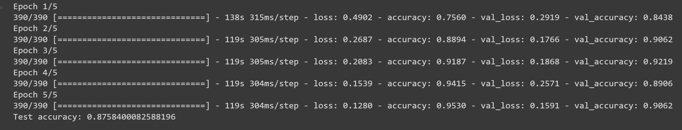
Final network
87,58 % total accuracy
5 epochs
1000 max words
64 batch size
5000 vocabulary size
64 embedding size
Notes:
JF

Slide 5
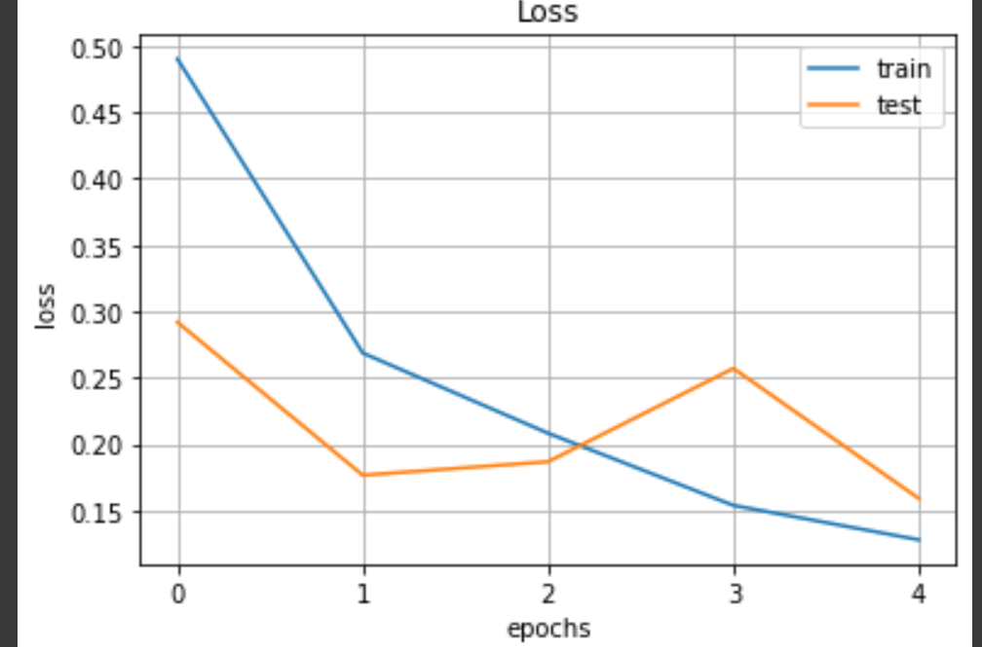
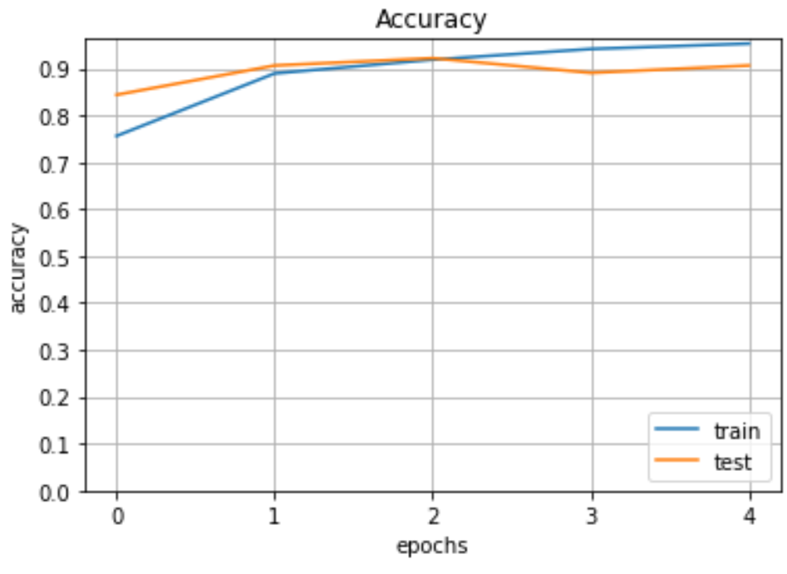
Results
Notes:
JF

Slide 6
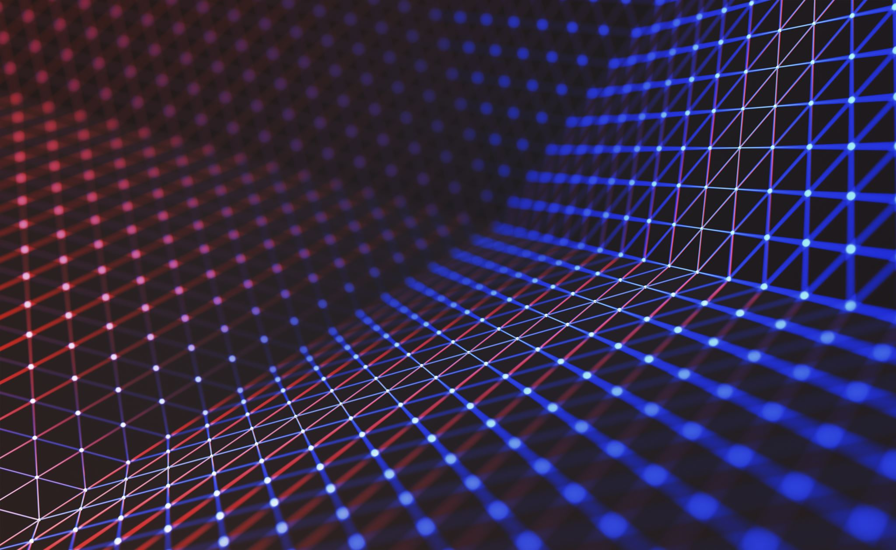
Inspiration
Foreign exchange currency rate prediction using a GRU-LSTM hybrid network, Islam et al., 2021
GRU(20) -> LSTM(256)
https://www.sciencedirect.com/science/article/pii/S2666222120300083
Applying Hybrid Lstm-Gru Model Based on Heterogeneous Data Sources for Traffic Speed Prediction in Urban Areas, Zafar et al., 2022
LSTM(256) -> LSTM(256) -> GRU(256) -> GRU(256)
https://mdpi-res.com/d_attachment/sensors/sensors-22-03348/article_deploy/sensors-22-03348-v2.pdf?version=1651206624
Notes:
JF

Slide 7
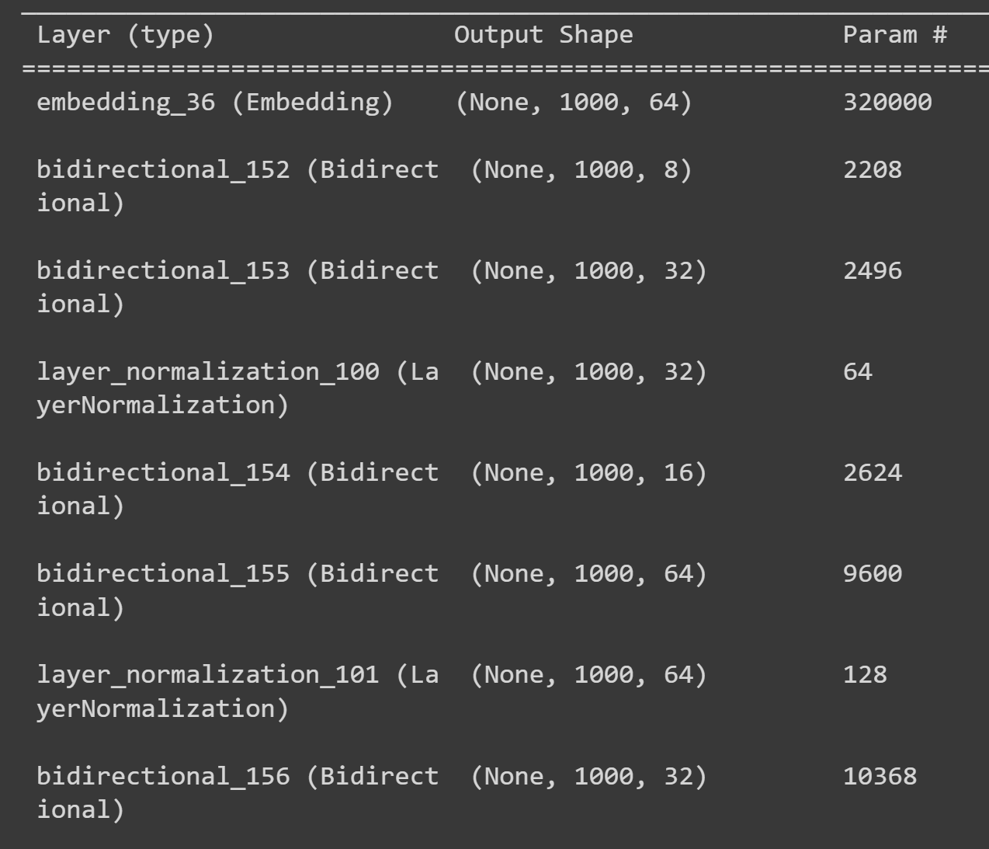
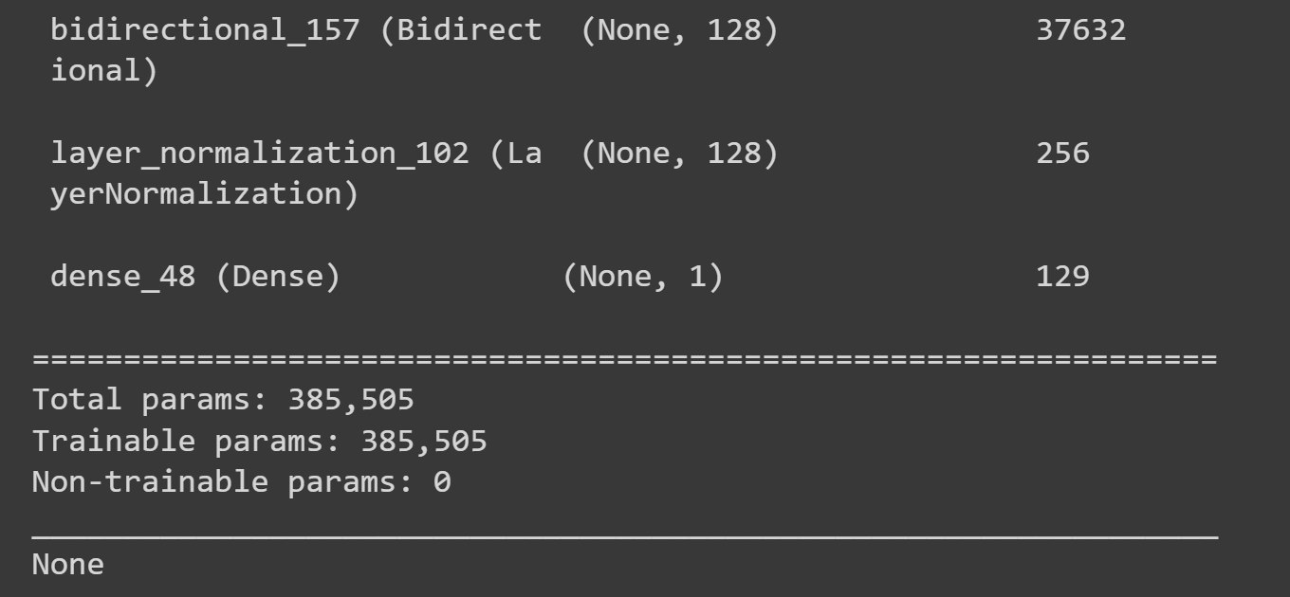
Notes:
JF

Slide 8
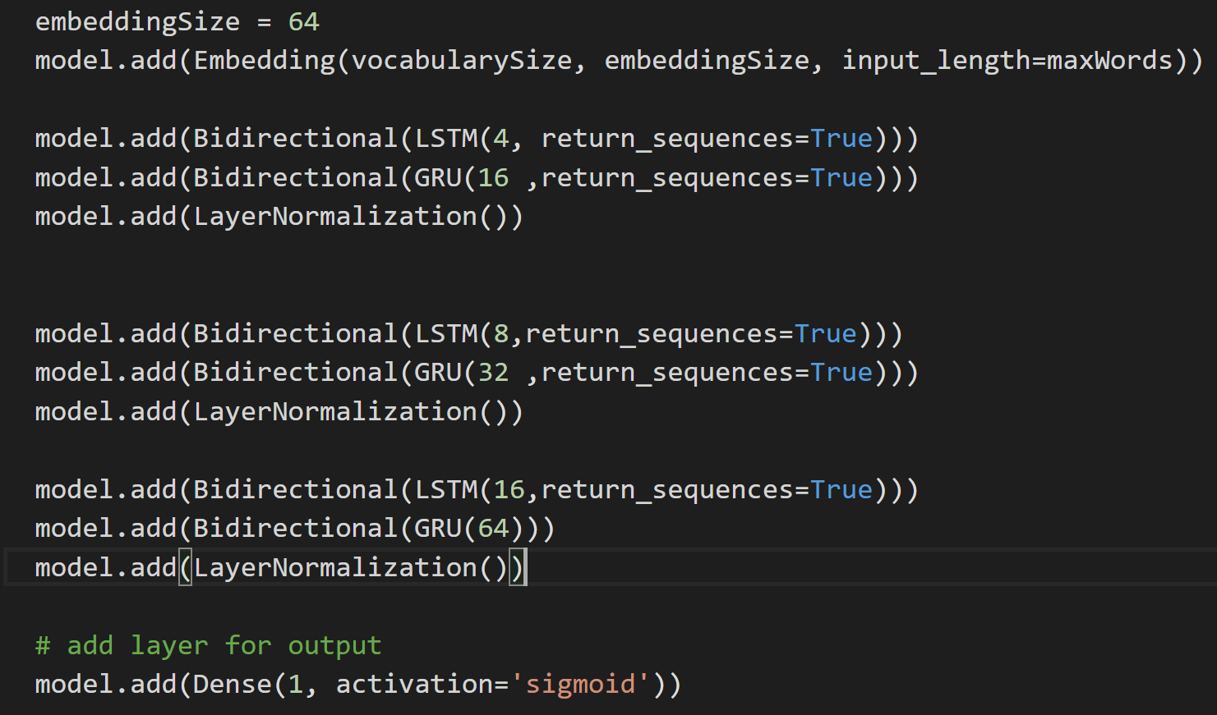
Final network
87,58% total accuracy
5 epochs
1000 max words
64 batch size
1000 vocabulary size
64 embedding size
Notes:
JF

Slide 9
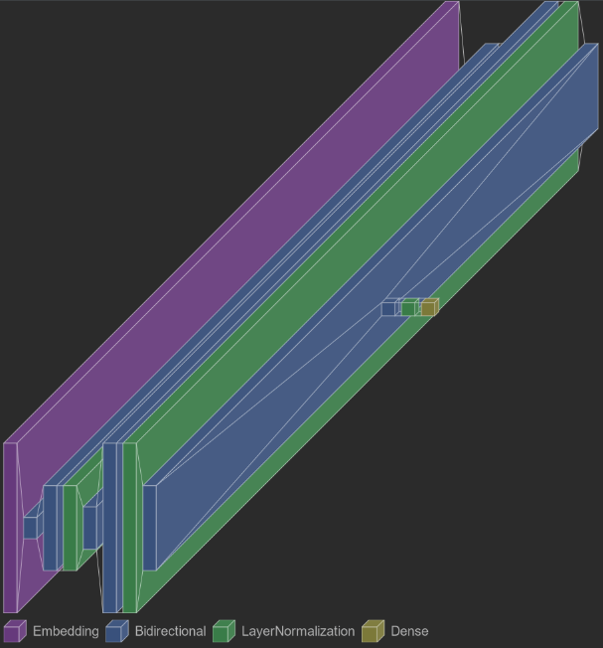
Layers
Notes:
JS
Now we will continue with the layers we used in our neural network, as we have already seen in the code in a previous slide. At first, as the data is often unstructured and noisy, we vectorized the data with the Embedding layer. Next we created a Stacked layout, where we added a bidirectional LSTM, followed by a bidirectional GRU and completed by a LayerNormalization. We repeated that step three times with different units for every iteration. The finalize the model, we added a Dense Layer.

Slide 10

Layers
Bidirectional
LSTM
Dense
GRU
Embedding
LayerNormalization
Notes:
JS
Embedding: turns integers into dense vectors.
LSTM: Long Short-Term Memory:
Solves short-term memory by remembering values over time intervals
GRU: Grated recurrent Unit
Performing better on smallers and less frequent datasets
Reason: more flexible
Layer Normalization:
Technique to normalize the distributions of layers.
Faster training and better accuracy
Dense:
Convert the final feature map to a fully connected layer
Changes the dimensions of the vector

Slide 11
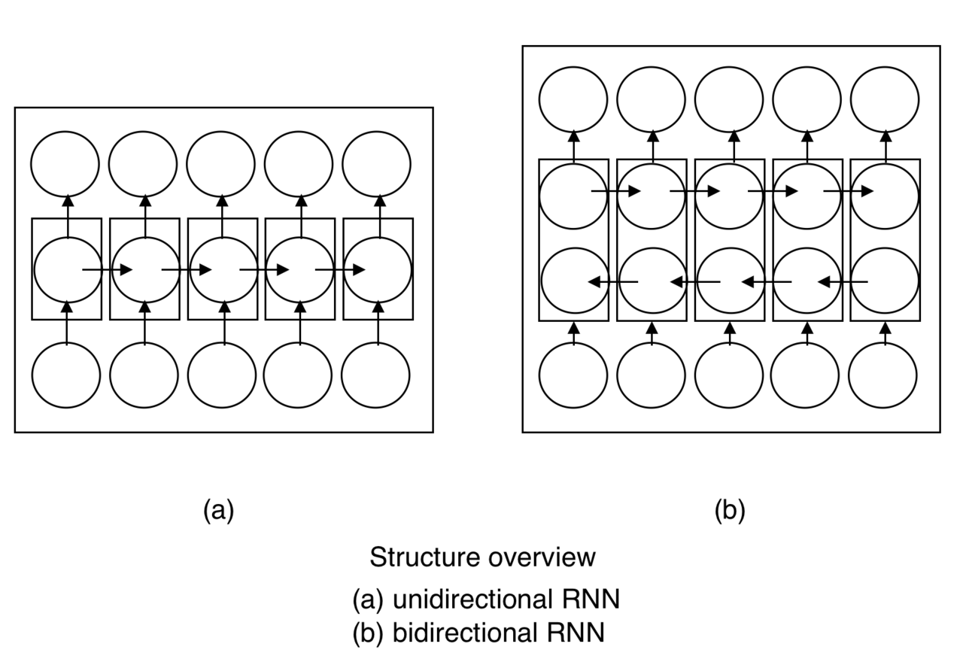
Bidirectional
Notes:
JS
Rnn relies on past and presetn events
Situations, where a prediction depends on the future as well
Enable straight and reverse traversal of the input → BRNN
Combination of 2 RNNs, one moves forward, one backwards
https://blog.paperspace.com/bidirectional-rnn-keras/

Slide 12
Stacked Layers
Deeper model
Higher accuracy
Alternative solutions
Less neurons and fast training
Need to return their full sequence
Notes:
JS
Used Stacked Architecture
Main benifit: model becomes deeper and more accurate
Additional layers are understood to recombine the learned representations from prior layers and create new representations
Increasing depth helps find alternate solutions, that require less neuros and allow faster training
Full sequence needs to be returned
https://machinelearningmastery.com/stacked-long-short-term-memory-networks/

Slide 13

Hyperparameters
Max Words
Number of Epochs
Batch Size
Vocabulary Size
Embedding Size
Notes:
Short explain

Slide 14
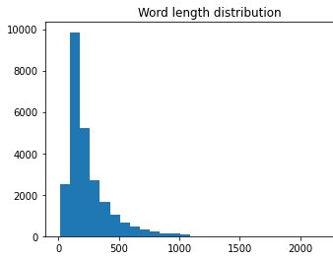
Max words
Most words used within the first 250 words
We used 250 for first test of a model
250 is faster than 1000
Final Result with 1000
Notes:
NT

Slide 15
Stopwords
Stopwords reduced accuracy
Some stopwords may be needed for understanding negative and positive reviews
"don't"
"not"
"didn't"
Notes:
NT

Slide 16
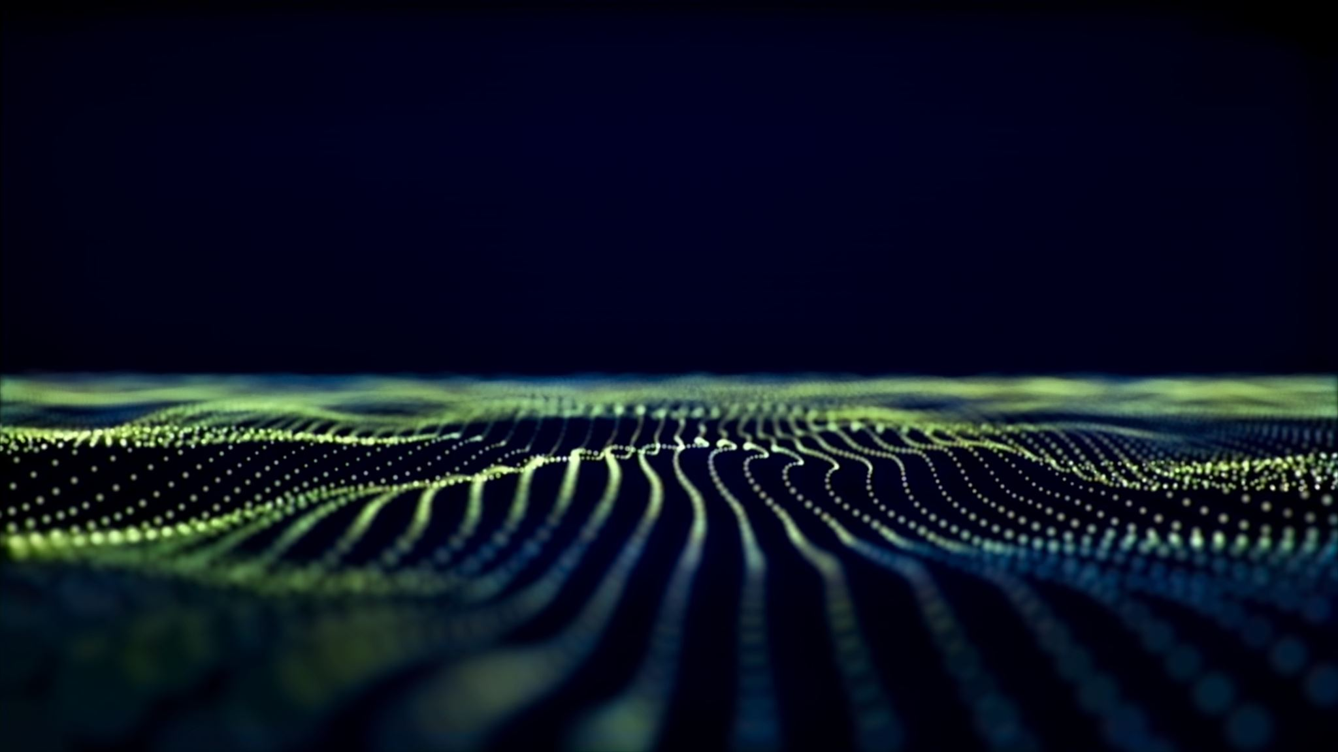
Vocabulary Size / Number of Epochs
Increased size increased training time
Vocabulary Size took to long
Number of Epochs increased → Fluctuation

Slide 17

Embedding Size / Batch Size
Not noticed any change
Embedding Size beyond 300-500 not good
In smaller project smaller sizes are fine
Small networks with large max words problem with small embedding Size
Notes:
NT

Slide 18
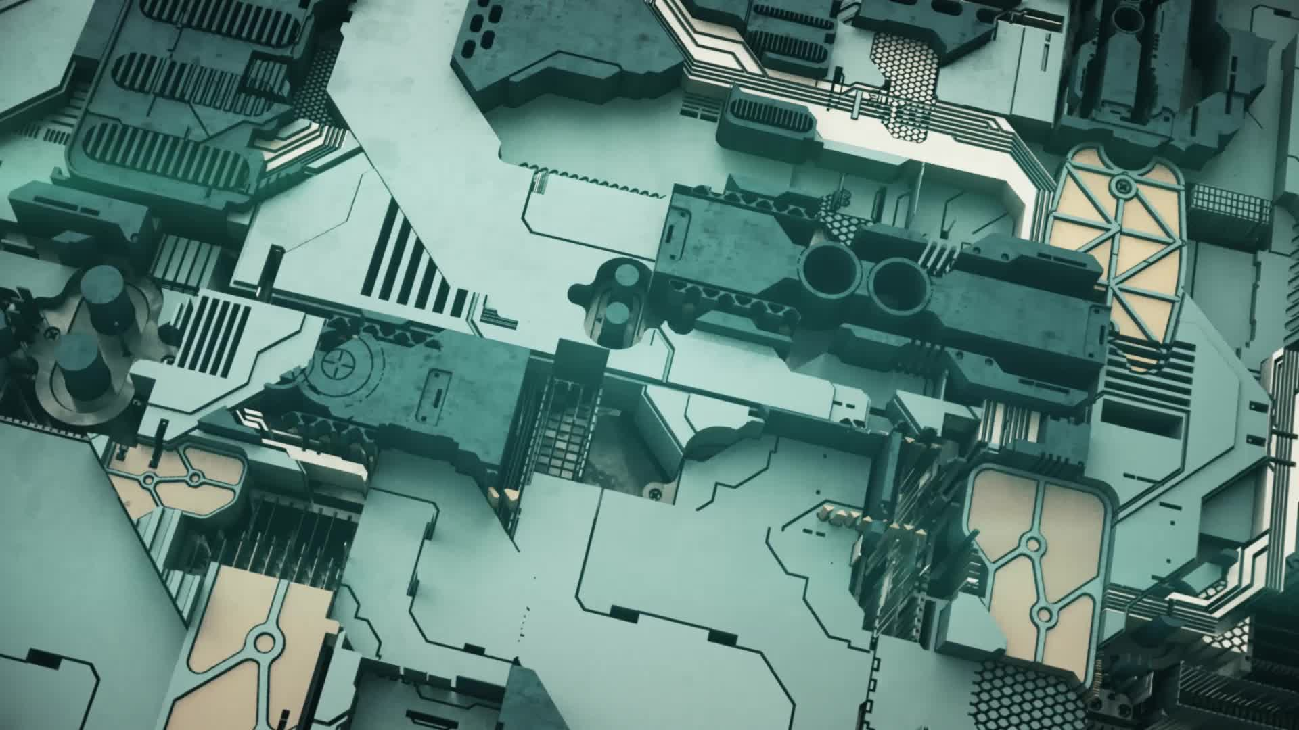
Review
Final Result
Hybrid Stacked LSTM & GRU
Stop words not good in our case
Small Neuronal Networks are nearly as good
Transformers would be better

Slide 19

Source Code
https://github.com/justinstroehleFH/NLP-Artificial-Intelligence
Notes:
NT

